Slide 1
Databases in Python
Adv. Python Programming – Module 8

Slide 2
Relational Database SQL
Adv. Python Programming

Slide 3
What is a relational database?
A relational database stores data in a table structure that provides powerful tools to retrieve data
Think of it as a separate application that does all the searching, filtering, and modifications for you
It also allows a place to enforce rules to the data and how it is stored
Databases are handled in “transactions” and when errors occur you can “rollback” changes
Data is organized in tables
The term “relational” means we can relate data in several tables together

Slide 4
Tables, rows and columns
Just as it sounds, data is stored in tables similar to a spreadsheet (CSV files) but with stronger rules and relationships
Columns define a field – attributes of an object
Rows represent a single record – one object
The table is a “category” of data
For our examples in the reading and here in the lecture we are going to imagine an online marketplace that has the following:
A product table that has name, brand, price and stock quantity
A review table that links to a product and has a rating, title, comment and reviewer

Slide 5
Primary and Foreign Keys
On major aspect of relational databases is that we need to have keys in our tables
Primary key is a unique identifier that distinguishes one row from another
This must be unique, not null and stable (non changing over time)
In many systems these keys are ‘artificial’ or auto generated by the system or auto-incremented by the database system starting with ‘1’
Foreign Keys are how we define our relationships for data in other tables
Take our products, for every review that we have you would need a column for each.
How many reviews do you have? What happens when you add a new review?
So instead we have a separate table where one of the columns is a foreign key that links to the primary key of the other table
Relationship types
one to one – one row links to only one row in another table
many to one – one row linkes to many rows in another table
Our reviews is a many to one with multiple reviews for one product

Slide 6
Common Relational Databases
There are many relational databases in use today
SQLite – file based – no server
MySQL/Maria DB (popular server-based)
PostreSQL (advanced open source)
Oracle (enterprise/commercial)
SQL Server (Microsoft enterprise)
All these as exampls follow industry standards but each have small differences in things like the data types, features and SQL syntax
For this class we will be using SQLite as it requires no server and you can include the file in your project
Make sure to add it to your git repository!
To interact/create a database externally you can use a program like DB Browser

Slide 7
SQL Commands
Adv. Python Programming

Slide 8
What is SQL?
Structured Query Language is the standard language used to communicate with relational databases
SQL is declarative meaning you describe what you want and the database engine determines how to retrieve it efficiently
SQL can very amongst different providers but they all have a core set of operations that appear that we summarize as CRUD
Create
Read
Update
Delete

Slide 9
Create Tables
Before you store any data, you need to define the tables them selves
For this we use the CREATE TABLE command
We often add the IF NOT EXISTS in as well in case the table is already there
We then define our columns with data types
INTEGER – whole numbers
REAL – decimal numbers
TEXT – strings
BLOB – raw binary data
Different databases implement these different – for example VARCHAR() is for text
Note on Date comparison, for SQLite it stores dates as TEXT format – but if we want to do comparison it uses lexicographical order – meaning dictionary based
“YYYY-MM-DD” is the order for the date of storing
Check the year first, then the month, then the day
You can also add modifiers onto the columns
NOT NULL
PRIMARY KEY
AUTOINCREMENT
UNIQUE
CREATE TABLE IF NOT EXISTS product ( id INTEGER PRIMARY KEY AUTOINCREMENT, name TEXT NOT NULL, brand TEXT NOT NULL, price REAL NOT NULL, stock_qty INTEGER NOT NULL ); CREATE TABLE IF NOT EXISTS review ( id INTEGER PRIMARY KEY AUTOINCREMENT, product_id INTEGER NOT NULL, rating INTEGER NOT NULL, title TEXT NOT NULL, comment TEXT NOT NULL, reviewer TEXT NOT NULL, FOREIGN KEY (product_id) REFERENCES product(id) );

Slide 10
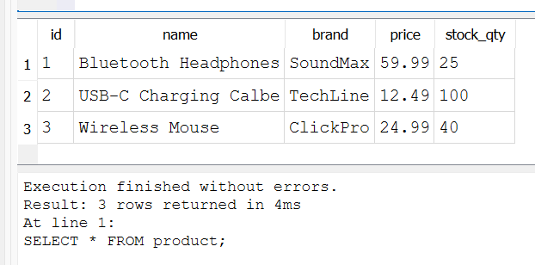
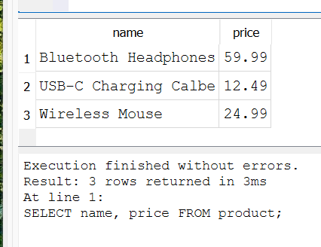
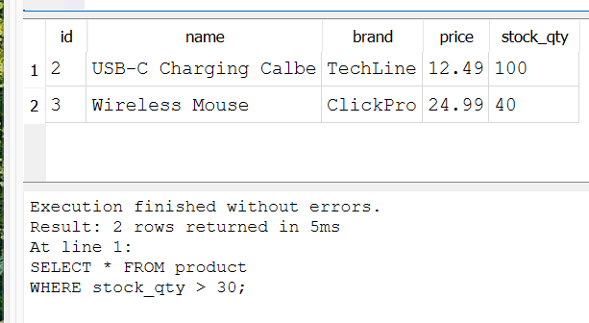
Read from tables (Query)
We will talk about inserting data next, but let’s assume we have some data in the table.
In order to see the data, we query the database
For this we use the SELECT command
We must define columns or use the asterisk as a “all” selector
Use the FROM to denote what table you are using
Add in the WHERE clause to limit/filter data
Use and relational operator and column name
SELECT * FROM product;
SELECT name, price FROM product;
SELECT * FROM product WHERE stock_qty > 30;

Slide 11
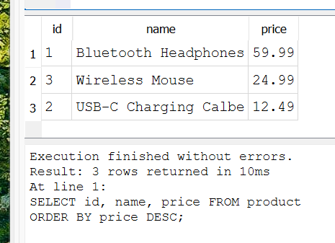
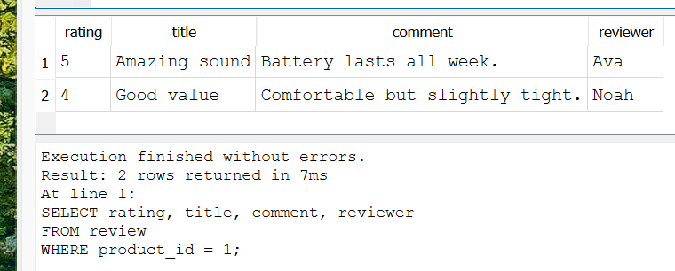
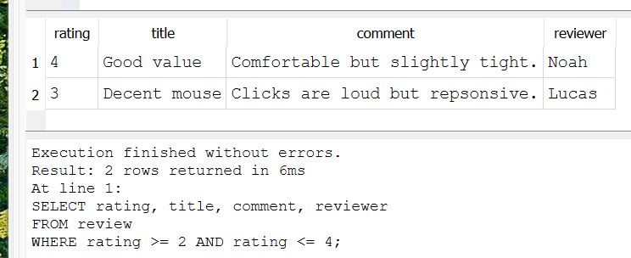
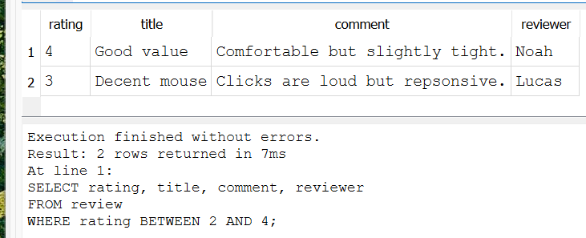
ORDER BY and Range checks
Use the ORDER BY with ASC or DESC for ordering the data and what column
To compare ranges use AND and BETWEEN for ranges
SELECT id, name, price FROM product ORDER BY price DESC;
SELECT rating, title, comment, reviewer FROM review WHERE product_id = 1;
SELECT rating, title, comment, reviewer FROM review WHERE rating >= 2 AND rating <= 4;
SELECT rating, title, comment, reviewer FROM review WHERE rating BETWEEN 2 AND 4;

Slide 12
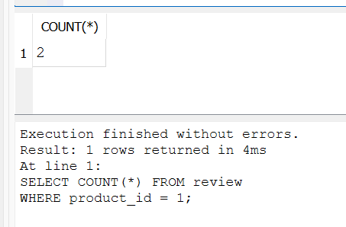
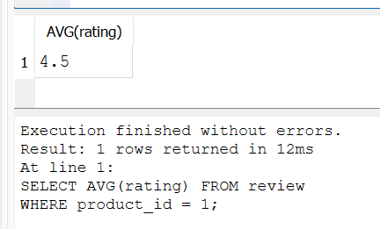
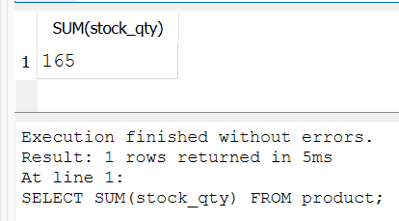
Aggregate Functions
Databases can do some calculations for you
You don’t need to program reading in all and doing the calculations yourself
COUNT()
AVG()
SUM()
and more
SELECT COUNT(*) FROM review WHERE product_id = 1;
SELECT AVG(rating) FROM review WHERE product_id = 1;
SELECT SUM(stock_qty) FROM product;

Slide 13
Inserting Data
Use the INSERT INTO command to add a row of data into your table
Define the table
Define the columns (optional)
If you have a column that is auto incrementing like an ‘id’ then you must define columns
Parenthesis with column names defined separated by commas
Define the VALUES
Parenthesis with values separated by commas
INSERT INTO product (name, brand, price, stock_qty) VALUES ('Bluetooth Headphones', 'SoundMax', 59.99, 25);
INSERT INTO review (product_id, rating, title, comment, reviewer) VALUES (1, 5, 'Great sound!', 'Battery lasted all week.', 'Ava');

Slide 14
Update a row
To update a row, the entire table or a selection of rows you use the UPDATE command
You must define the table
Use the SET command to define what columns and what should be updated with an ‘=‘
Include the WHERE clause to limit what rows to update
UPDATE product SET stock_qty = 20 WHERE id = 1; UPDATE product SET price = price * 1.05;

Slide 15
Delete
The DELETE command can be use to remove rows from a table
Always be careful with delete to include a WHERE clause otherwise you delete all the data in a table
Often times in the business environment you will have users for a database and set privileges
This way you can’t delete data
You can also use the DROP command on a table to delete the table entirely
You may not ever want to delete but instead have properties like “active” or “inactive” for accounts
When deleting if there are any relationships with foreign keys errors can occur
In our example, we have review tied to products, if we try to delete a product with reviews then we will get a foreign key constraint error
There are some settings we can adjust to CASCADE delete – we won’t worry about this now
Or just make sure to delete all reviews first before deleting a product
DELETE FROM review WHERE id = 10;
DROP TABLE review;

Slide 16
SQL coding style
Typically on SQL commands we put them in all caps
Usually table names and columns are in lower case
If a column contains two words we use an underscore for the name
Usually we each SQL commands on new lines
Each SQL command ends in a semi colon
When putting SQL in a different coding environment we don’t need it
SELECT * FROM table_name WHERE id = 7 ORDER BY price ASC;

Slide 17
Coding Example – Using DB Browser
We need a database for our Bank Account System
The design should mirror our objects
BankAccounts - we have checking and savings with different column values
Transactions – multiple transactions per account – many to one
Owner – can be multiple owners per account – many to many
Many owners to many bank accounts – need a bridge table to show this
Anything that is a list on an object is most likely a relationship!
Let’s create those tables using the DB Browser.

Slide 18
SQLite3 Connecting to Database
Adv. Python Programming

Slide 19
SQLite in Python – Connect and Cursor
Python includes a built-in library called sqlite3
We must import it and call the connect() function sending the name of the database to connect to
There are some optional parameters we can include
timeout – how long before database is locked
detect_types – parse specialized types like dates
check_same_threat – used in threaded applications
isolation_level – controls transaction behavior
Once you get your connection we need to get the cursor object
This is used to execute SQL statements and retrieve the results from the database
import sqlite3 conn = sqlite3.connect("store.db")
conn = sqlite3.connect("store.db", timeout=10)
cursor = conn.cursor()

Slide 20
Creating some tables
CREATE_PRODUCT_TABLE = """ CREATE TABLE IF NOT EXISTS product ( id INTEGER PRIMARY KEY AUTOINCREMENT, name TEXT NOT NULL, brand TEXT NOT NULL, price REAL NOT NULL, stock_qty INTEGER NOT NULL );"""
CREATE_REVIEW_TABLE = """ CREATE TABLE IF NOT EXISTS review ( id INTEGER PRIMARY KEY AUTOINCREMENT, product_id INTEGER NOT NULL, rating INTEGER NOT NULL, title TEXT NOT NULL, comment TEXT NOT NULL, reviewer TEXT NOT NULL, FOREIGN KEY(product_id) REFERENCES product(id) );"""
cursor.execute(CREATE_PRODUCT_TABLE) cursor.execute(CREATE_REVIEW_TABLE)
As we learned about SQL earlier, we can run our CREATE TABLE commands
For this we will use multi line string denoted by 3 single or double quotes
Then open and close the block of text
Then on the cursor objects we have the execute() function to run single SQL commands

Slide 21
Inserting some data
Then we can insert some data
Say we have data in a list, we can use the SQL and loop through inserting data
After we do any modification to the database we must commit() the changes
This permanently saves changes to the database – if a program crashes before SQLite can rollback the transaction automatically
Then close() the connection
We are using Parameterized Statements with the “?” to insert the data
INSERT_PRODUCTS = """ INSERT INTO product (name, brand, price, stock_qty) VALUES (?, ?, ?, ?) """
products = [ ("Bluetooth Headphones", "SoundMax", 59.99, 25), ("USB-C Charging Cable", "TechLine", 12.49, 100), ("Wireless Mouse", "ClickPro", 24.99, 40) ] for p in products: cursor.execute(INSERT_PRODUCTS, p)
cursor.execute("SELECT id FROM product ORDER BY id") product_ids = [row[0] for row in cursor.fetchall()]
INSERT_REVIEWS = """ INSERT INTO review (product_id, rating, title, comment, reviewer) VALUES (?, ?, ?, ?, ?) """
reviews = [ (product_ids[0], 5, "Amazing sound", "Battery lasts all week.", "Ava"), (product_ids[0], 4, "Good value", "Comfortable but slightly tight.", "Noah"), (product_ids[1], 5, "Perfect cable", "Works exactly as expected.", "Mia"), (product_ids[2], 3, "Decent mouse", "Clicks are loud but responsive.", "Lucas") ] for r in reviews: cursor.execute(INSERT_REVIEWS, r)
conn.commit()
conn.close()

Slide 22
Parameterized Statements and SQL Injection
SQL Injection is a vulnerability that happens when a program builds SQL using raw user input and it bypasses checks/security of the database
‘ OR 1=1 –’ is always true so it will reveal the entire table
Access to private data like SSN, Credit cards, etc.
Instead use parameterized commands with “?” where they get replaced from values noted after
SQL treats the parameter as data/text only and not SQL commands
Note that the data being inserted is in the form of a tuple. Even if it is a size 1 tuple, to do this you add a comma in the parentheses
(name,)
name = input("Product name: ") sql = f"SELECT * FROM product WHERE name = '{name}'" cursor.execute(sql)
SELECT * FROM product WHERE name = '' OR 1=1 --’
cursor.execute("SELECT * FROM product WHERE name=?",(name,))

Slide 23
Design Pattern -> Connection Factory
As soon as your program starts to interact with a database over and over and in multiple places, we have a repeating pattern
Connect to database
Create cursor
Turn on foreign key enforcement (for SQLite)
Execute SQL commands and process data
Commit if needed
Close the connection
If you copy and paste that setup code of connecting to the database it makes it harder to maintain
What happens when the database name changes?
What happens if you forget to force foreign keys?
A better approach is to create one function that is our connection which enters into a factory function – a function that has the job to create and return other objects in a consistent way

Slide 24
Connection Factory
We have a couple ways that you can set up.
You can accept the name of the database to always open
Or you can have a constant value for the database to open
Subsequently we could treat this like an object and have a class, have getter/setters to change the name of the DB if needed
Lastly not shown here, we could have the DB use system arguments or environment variables so that it can be changed based on the system it is running on
The key here is, we are connecting to our database, applying settings with the cursor, then returning the connection
Note we aren’t returning the cursor because we need the full connection to be able to commit and close. We can always get the cursor in our CRUD functions
import sqlite3 def get_connection(db_name: str = "store.db") -> sqlite3.Connection: conn = sqlite3.connect(db_name, timeout=10) cursor = conn.cursor() cursor.execute("PRAGMA foreign_keys = ON;") return conn
import sqlite3 DB_URL = "store.db" def get_connection()-> sqlite3.Connection: conn = sqlite3.connect(DB_URL,) cursor = conn.cursor() cursor.execute("PRAGMA foreign_keys = ON;") return conn

Slide 25
Insert in Python
Adv. Python Programming

Slide 26
Managing Errors in Databases
Database operations are one of the most failure prone parts of an application
This could be an error on the connection
Error on any insert, update or delete operation
Invalid foreign key constraints
These errors typically have our libraries throw exceptions, so we need to mitigate these
We should gracefully handle fails instead of crashing
Roll back changes if something goes wrong
Return useful feedback to the rest of the program
Think True/False if successful, the item’s ID or -1(if error), etc.
We also need to make sure and close our connection
You may think, “can we use ‘with’ like we did in files?”
The answer is YES! but with how we are setting up our connection factory to handle other errors, we can’t do that here.
If you had just one function that gets a connection you can use with to handle roll back and closing, instead we use the catch and finally
Add in the exception to print out when debugging errors
try: cursor.execute("SQL command here") conn.commit() return something here for ‘successful’ except: conn.rollback() return something here for ‘error’ state finally: conn.close() # close no matter error or not
except Exception as ex: print(ex) conn.rollback() return something here for ‘error’ state

Slide 27
Inserting Records
When inserting we create a SQL statement based on the design of the database
Is there an autoincrement primary key?
Do you have the foreign key to match up?
etc.
Use parameterized statement to insert data avoiding SQL injection
Often times we create a function that accepts an object, and use the getters/properties defined to insert
Works well for very large objects with say 5+ properties, otherwise you could send all the data over in parameters
Note that this function returns the lastrowid off the cursor
Alternatively, you could do a return True/False
If there is an error we return -1 as the id doesn’t exist
def insert_product(product : Product -> int: conn = get_connection() cursor = conn.cursor() try: cursor.execute( "INSERT INTO product (name, brand, price, stock_qty) VALUES (?, ?, ?, ?)", (product.name, product.brand, product.price, product.stock_qty)) conn.commit() return int(cursor.lastrowid) except: conn.rollback() return -1 finally: conn.close() # close no matter error or not

Slide 28
Inserting a Review
Same thing goes for if we want to insert a review of our products
Since we have the foreign key for the products, the database enforces that this must match in our product table
If foreign key doesn’t match, then an error occurs and the except will rollback
Again returning the last row id that was inserted or -1 if there is an error
def insert_review(review : Review) -> int: conn = get_connection() cursor = conn.cursor() try: cursor.execute( """ INSERT INTO review (product_id, rating, title, comment, reviewer) VALUES (?, ?, ?, ?, ?)""", (review.product_id, review.rating, review.title, review.comment, review.reviewer)) conn.commit() return int(cursor.lastrowid) except: conn.rollback() return -1 finally: conn.close() # close no matter error or not

Slide 29
Coding Example – Insert Data
Make a helper database creator/reading in the data
Eliminate our saving to XML, JSON and CSV files
Insert owners
Insert transactions
Can we insert accounts yet? Do we need queries for getting the owner when making an account?

Slide 30
Query in Python
Adv. Python Programming

Slide 31
Querying Data – one, all, or many
To query our database we need to execute a SELECT command
This query can return one or a lot of records, we have several functions to handle that data
fetchall() – to get all rows returned
fetchone() – to get one – the first record in the row(s) returned
fetchmany() – to get a set amount of rows
What do we do with the data then?
We need to process it!
Depending on your system design you may just directly access or typically we convert it to our objects
class Review: def __init__(self, review_id: int=0, product_id: int, rating: int, title: str, comment: str, reviewer: str): self.review_id = review_id self.product_id = product_id self.rating = rating self.title = title self.comment = comment self.reviewer = reviewer
class Product: def __init__(self, product_id: int=0, name: str, brand: str, price: float, stock_qty: int, reviews=None): self.product_id = product_id self.name = name self.brand = brand self.price = price self.stock_qty = stock_qty self.reviews = reviews if reviews is not None else []

Slide 32
fetchall()
The most basic of all the functions is the fetchall() for all the data
You need to execute a SELECT query on the cursor
Then on the cursor call the fetchall() function
It returns a list of tuples
Remember tuples are immutable as this data is read only, it makes sense to use that data type
You can then access the index locations and grab the data
Note you must understand the order of information you grabbed whether it be all (*) or specific columns
def get_all_products() -> list[Product]: conn = get_connection() cursor = conn.cursor() cursor.execute("SELECT * FROM product") rows = cursor.fetchall() products = [] for row in rows: reviews = get_product_reviews(row[0]) products.append(Product(row[0], row[1], row[2], float(row[3]), int(row[4]), reviews)) conn.close() return products

Slide 33
What about this reviews function?
You may see this function in the last code for getting reviews
Depending on the makeup of your objects you may need more queries to get subsequent data – like if your object has a list
There are more advanced ways to do this with JOIN statements or even sub queries.
I chose to keep this basic and do simple queries.
def get_product_reviews(product_id: int ) -> list[Review]: conn = get_connection() cursor = conn.cursor() cursor.execute( "SELECT * FROM review WHERE product_id = ? ORDER BY id", (product_id,)) rows = cursor.fetchall() reviews = [Review(r[0], r[1], int(r[2]), r[3], r[4], r[5]) for r in rows] conn.close() return reviews

Slide 34
fetchone()
If you are searching for one row in a database OR you get back a list of rows and you want to get the first row then we use fetchone()
fetchone() will return a tuple of the object or if no rows appear it will be None
Again you then process the data as needed
def get_product_by_id(product_id: int) -> Product | None: conn = get_connection() cursor = conn.cursor() cursor.execute("SELECT * FROM product WHERE id = ?", (product_id,)) row = cursor.fetchone() conn.close() if row is None: return None return Product(row[0], row[1], row[2], float(row[3]), int(row[4]), get_product_reviews(row[0]))

Slide 35
fetchmany() for size limit
In many real-world systems, tables may contain millions of rows
So pulling all the rows at once wastes time and memory on the database
Especially because we have multiple people accessing a database at once
For this reason we have fetchmany(size) to help us limit the number of rows to get
There are also some SQL query properties we can set as well to give us certain number of records
Make sure when you do your SQL query that you typically order the data as without doing that each query can mix data rows up and not be in the same order
Note the added Pythonic operation of getting the reviews of products via a comprehension
def get_products_page(page_size: int) -> list[Product]: conn = get_connection() cursor = conn.cursor() cursor.execute("SELECT * FROM product ORDER BY id") rows = cursor.fetchmany(page_size) products = [Product(r[0], r[1], r[2], float(r[3]), int(r[4]), get_product_reviews(r[0])) for r in rows] conn.close() return products

Slide 36
Coding Example – Query Data
Query our application for all accounts
Query owners for searching
Query owners when adding new accounts on main
View Accounts
Filtering Accounts
Finish connecting INSERTs within the database file and main

